Slide 1
Data Processing System
10/16/2020 Update

Slide 2
Overview
DPS UI
Administrator interface
End-user interface

Slide 3
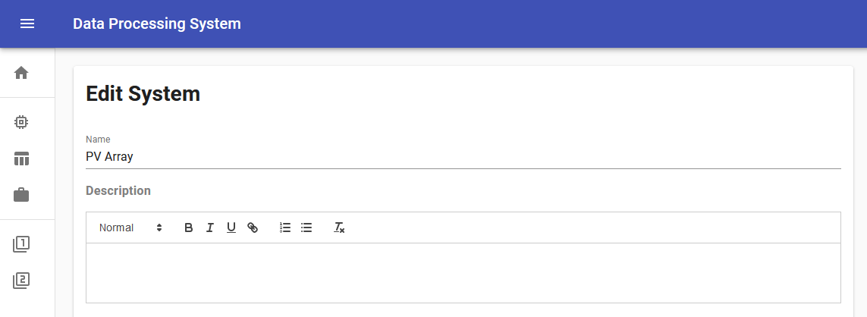
DPS UI – Administrator Interface - Systems

Slide 4
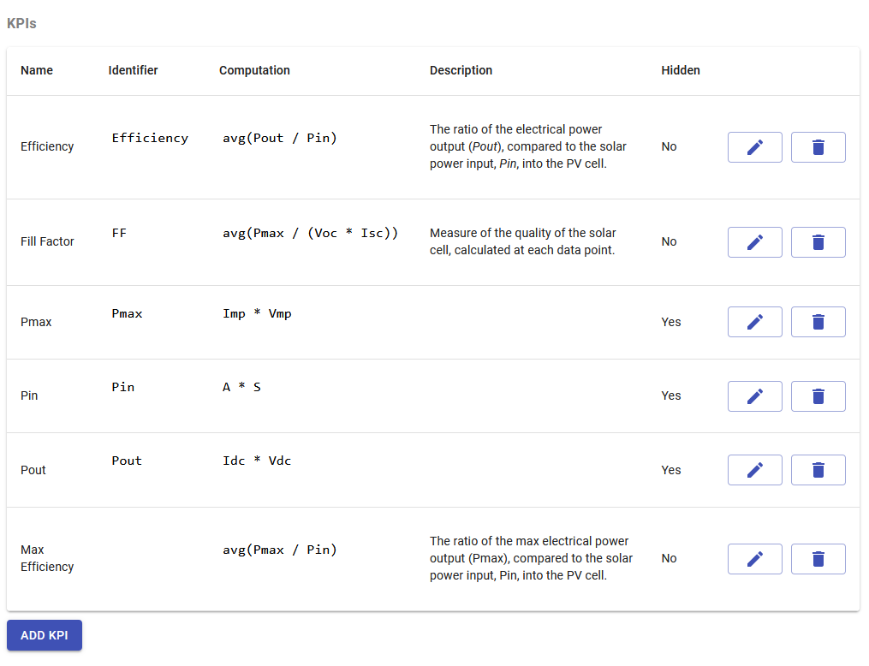
DPS UI – Administrator Interface - Systems

Slide 5
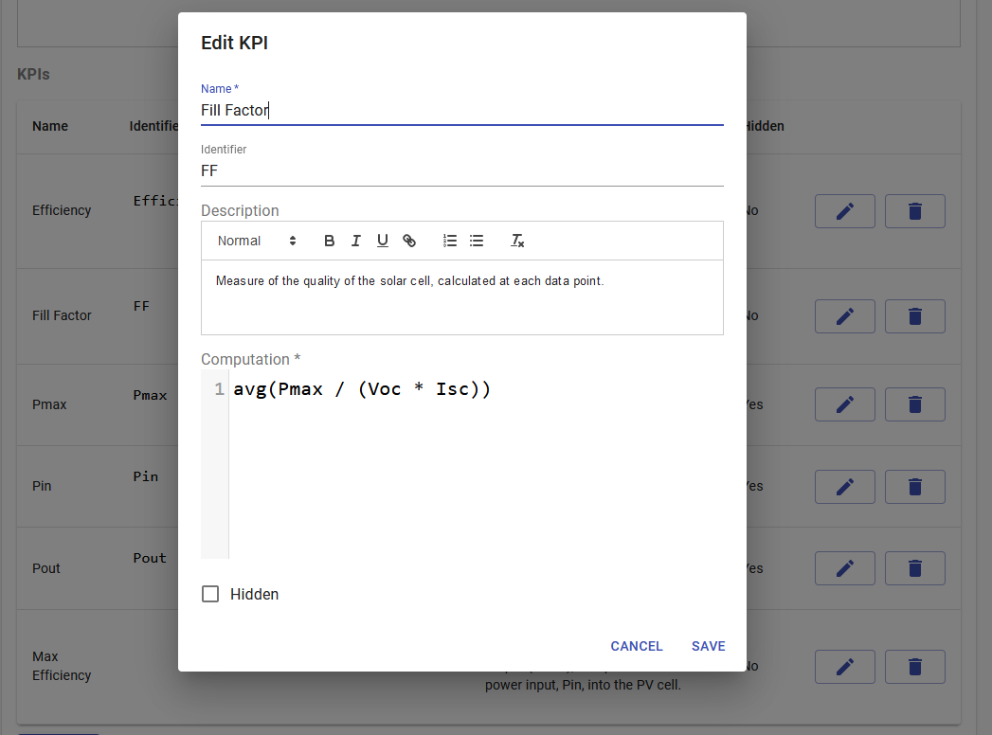
DPS UI – Administrator Interface - Systems

Slide 6
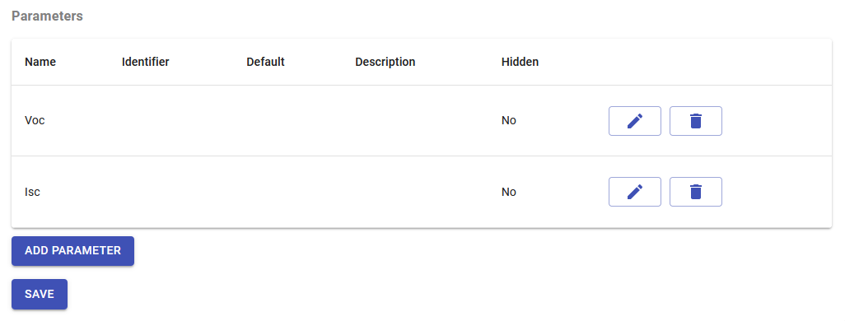
DPS UI – Administrator Interface - Systems

Slide 7
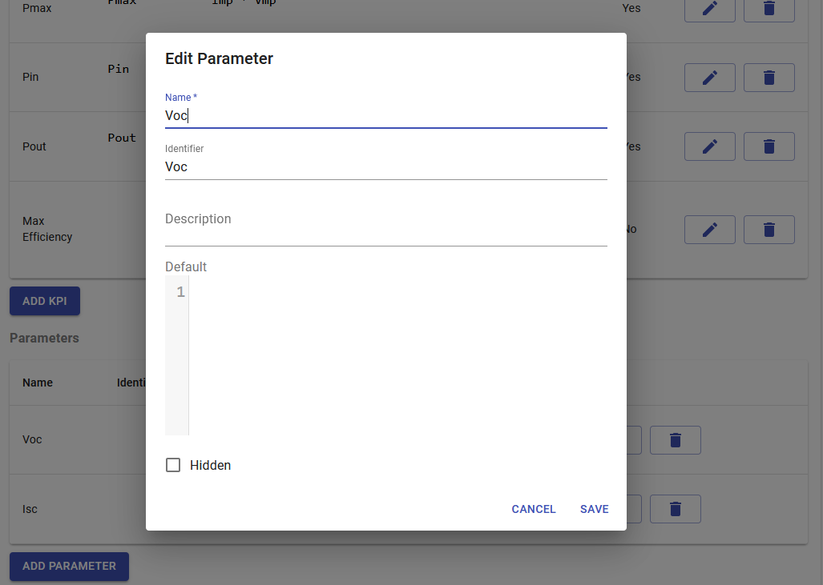
DPS UI – Administrator Interface - Systems

Slide 8
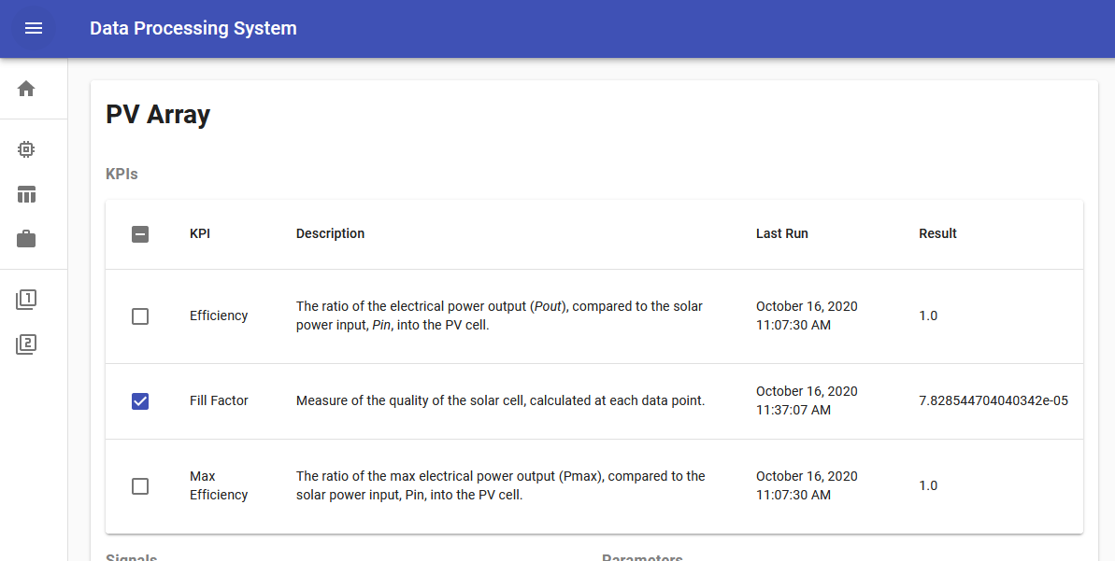
DPS UI – End-User Interface – Batch Process

Slide 9
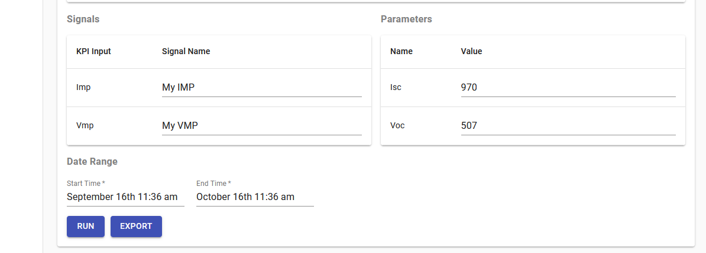
DPS UI – End-User Interface – Batch Process

Slide 10
Questions

